Slide 1
Lecture-11
Integrated Circuit Logic Families
Classification of digital ICs
Complexity | Gates per chip
Small scale integration (SSI) | Fewer than 12
Medium scale integration (MSI) | 12 to 99
Large scale integration (LSI) | 100 to 9999
Very large scale integration (VLSI) | 10,000 to 99,999
Ultra large scale integration (ULSI) | 100,000 to 999,999
Giga scale integration (GSI) | 1,000,000 to more

Slide 2
Bipolar and Unipolar digital ICs
Bipolar ICs- bipolar junction transistor (NPN or PNP)
Unipolar ICs- unipolar field effect transistor (P channel and N channel MOSFET)

Slide 3
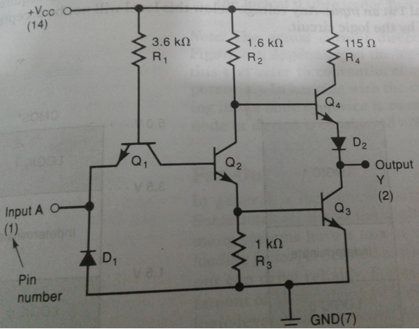
Bipolar digital ICs
Transistor –transistor logic:
The major family of bipolar digital ICs for over 30 years.
74 series was the first series of TTL ICs.
It is the leading family in the SSI and MSI categories up until the last 12 or so years.

Slide 4
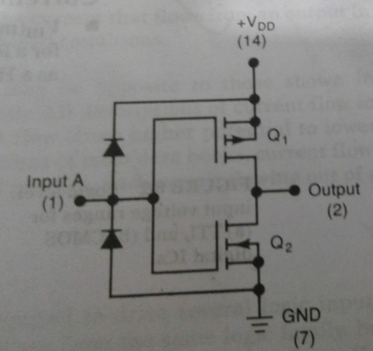
Unipolar digital ICs
Complementary Metal oxide semiconductor (CMOS) MOSFET
Simplicity
Compactness

Slide 5
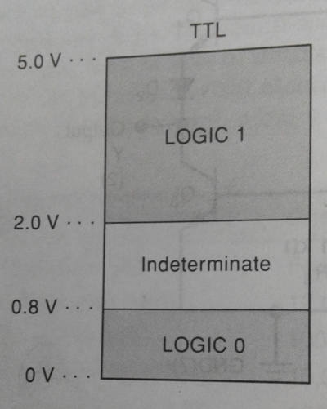
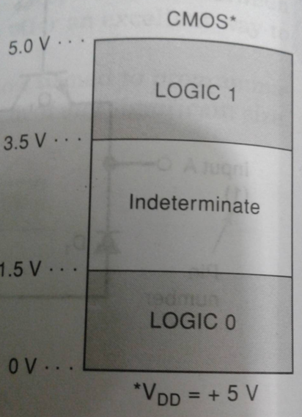
Logic level voltage ranges

Slide 6
Current and voltage parameters
High level input voltage –V_{IH} (min): The minimum voltage level required for a logical 1 at an input. Any voltage below this level will not be accepted as HIGH by the logic circuit.
Low level input voltage –V_{IL} (max): The maximum voltage level required for a logical 0 at an input. Any voltage above this level will not be accepted as a LOW by the logic circuit.
High level output voltage –V_{OH} (min): The minimum voltage level at a logic circuit output in the logical 1 state under defined load conditions.
Low level output voltage –V_{OL} (max): The maximum voltage level at a logic circuit output in the logical 0 state under defined load conditions.

Slide 7
Current and voltage parameters
High level input current –I_{IH} : The current that flows into an input when a specified high level voltage is applied to that input.
Low level input current –I_{IL} : The current that flows into an input when a specified high level voltage is applied to that input.
High level output current –I_{OH} : The current that flows from an output in the logical 1 state under specified load conditions.
Low level output current –I_{OL} : The current that flows from an output in the logical 0 state under specified load conditions.

Slide 8
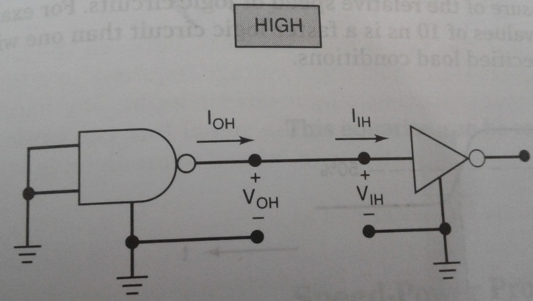
Currents and voltages of the logic states

Slide 9
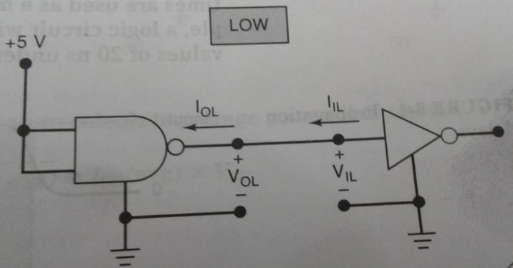
Currents and voltages of the logic states

